Slide 1
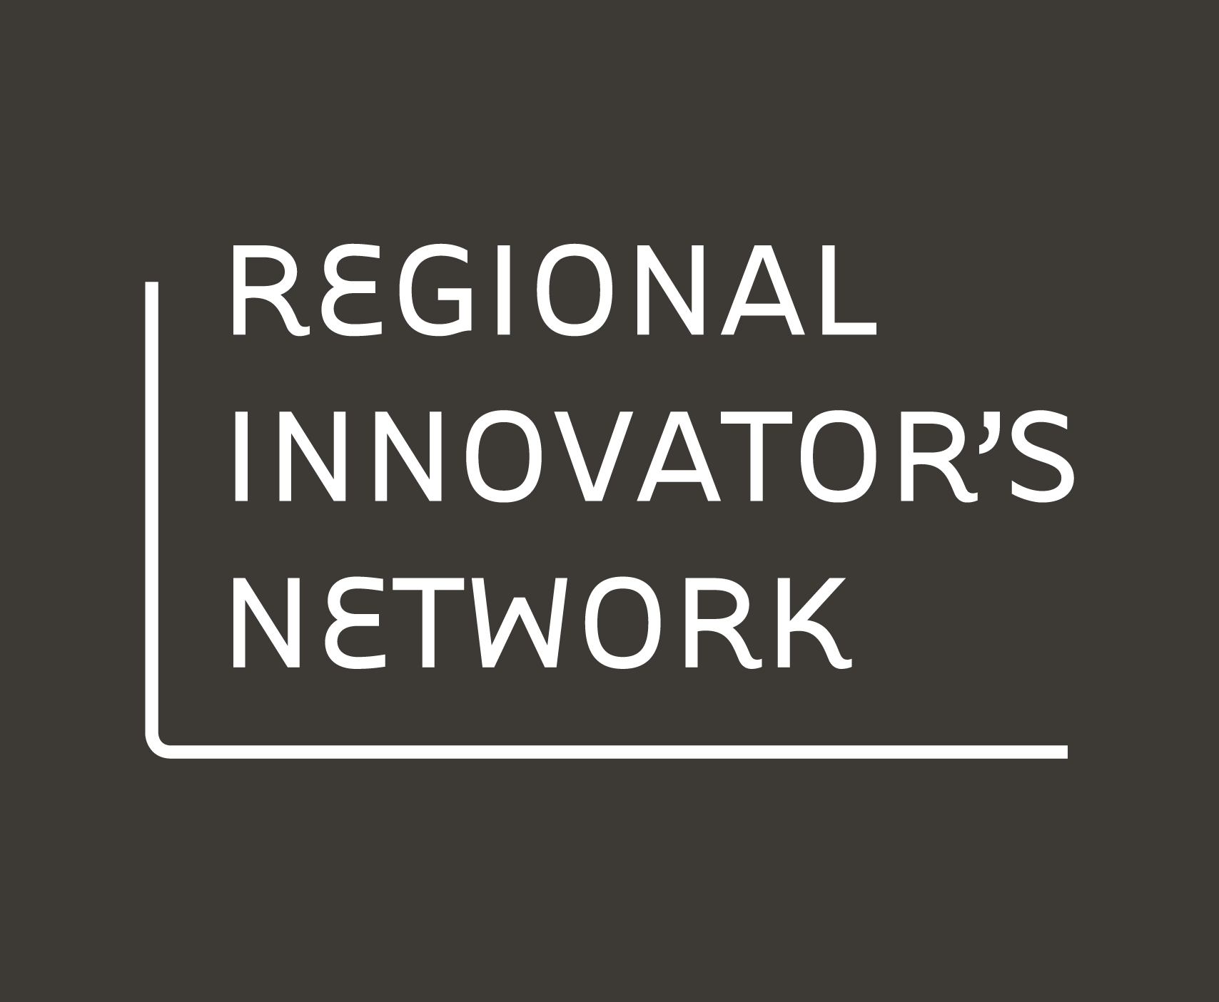
Gathering & analyzing outcomes

Slide 2
Collecting and
understanding evidence
in order to assess impact

Slide 3
Content
Naming outcomes – working with Theory of Change
What is evidence?
Monitoring & evaluation (MEL) – InDeep Framework
Evaluation process
Evaluation methods for early stage innovation

Slide 4
Starting with the end in mind
Naming outcomes and working with a Theory of Change

Slide 5
Naming outcomes
An outcome is the change or impact you hope to achieve. Before we can begin to think about evaluation, we need to identify outcomes. Steps to identify outcomes:
Identify your long-term goals, short-term goals and outputs.
Long-term goals: aspirational hopes and not directly linked to the solutions you are seeking to test. In the context of regional innovation, long term goals are often the social change or impact you are hoping to achieve for communities, families and young people. Example – the percentage of young people who have interactions with the justice system in Dubbo is reduced to be on par with or below the national average
Short-term goals: outcomes that you will be able to measure and you can influence with the solutions that you are seeking to test. Often are the direct results of a project or participation in a program. Example – after participation in the new youth program, at-risk young people demonstrate improved social and emotional awareness and resilience
Outputs: the deliverable, often what gets funded. Example – delivery of a new youth program
Map how these are linked with one another.
Name the assumptions that lay behind these connections. What needs to be true in order to deliver outputs and achieve short- and long-term goals?

Slide 6
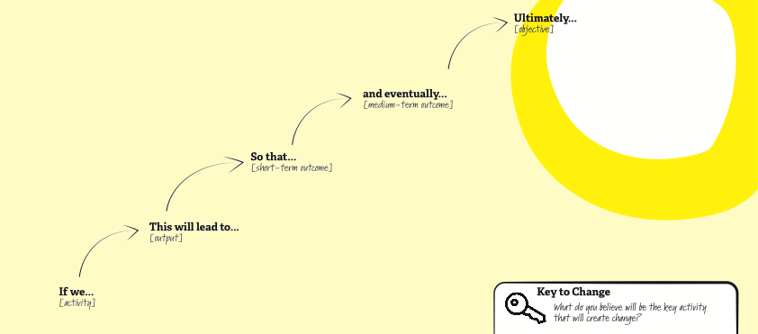
Working with Theory of Change
Example: ‘Impact story’ – A narrative version of Theory of Change
Identify the outcomes
Link: https://regionalinnovation.com.au/network/tools/tool-2

Slide 7
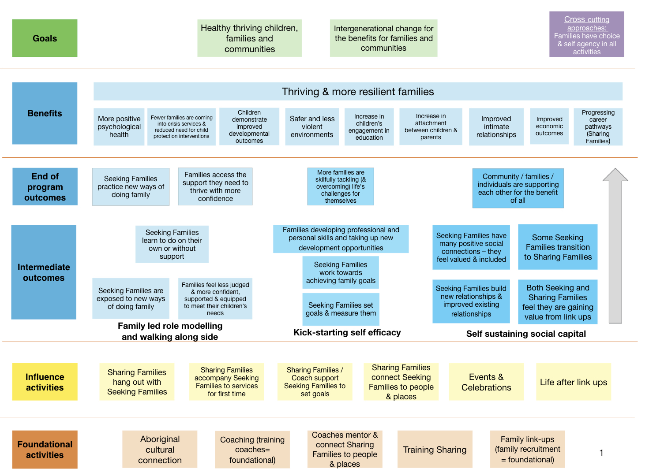
Theory of Change example: Program logic version – Family by Family
Reflects 6 years of implementation and 4 evaluations
Link: Program logic FBYF TOC : https://www.dropbox.com/s/5ao9shccq73qzjk/FBYF%20TOC.tiff?dl=0
Narrative TOC for FBYF kids-focused coaching work is located here – testing and innovation phase https://www.dropbox.com/s/lnop130zzf4pksc/FbyF%20Theory%20of%20change.pdf?dl=0

Slide 8
What is evidence?
Evidence is data – facts and information – that demonstrates whether a proposition is true and valid. In innovation, evidence is sought to determine a link (or lack thereof) between action and outcome. In gathering evidence, questions of authenticity, bias, repeatability, substantiveness and correlation to claim must be addressed.
Notes:
Definition

Slide 9
There is never evidence for an idea that hasn’t been tried yet

Slide 10
There is never evidence for what will work in the future

Slide 11
Numerous methods exist for evaluating well developed ideas. But it is less common to evaluate emerging ideas – e.g. evaluate during the early stages of innovation.

Slide 12
In order to evaluate innovation we require a different approach than traditional evaluation, new methods and a context-specific definition of valid evidence.

Slide 13
Developmental evaluation is the name of the emerging form of evaluation that is specific to the early stages of innovation

Slide 14
Developmental evaluation
Developmental Evaluation (DE) is an evaluation approach that can assist social innovators develop social change initiatives in complex or uncertain environments. DE originators liken their approach to the role of research & development in the private sector product development process because it facilitates real-time, or close to real-time, feedback to program staff thus facilitating a continuous development loop.
Michael Quinn Patton is careful to describe this approach as one choice that is responsive to context. This approach is not intended as the solution to every situation.
Development evaluation is particularly suited to innovation, radical program re-design, replication, complex issues, crises
In these situations, DE can help by: framing concepts, test quick iterations, tracking developments, surfacing issues.
Link: https://www.betterevaluation.org/en/plan/approach/developmental_evaluation

Slide 15
Goals in the early stages of innovation:
Establish a baseline
Understand where there is potential
Build an argument for how to move forward
Obtain buy-in and investment in further stages

Slide 16
What evidence do you need?
The evidence needed is determined by what you are trying to measure. For instance, are you measuring social impact, process improvement, personal development, etc.?
During the early stages of innovation you are often trying to assess the potential and probability for your ideas to create the desired impact. Process and capability impacts are often assessed at this stage.
Social impact, e.g. impact at a population level takes time to achieve and it is rarely (maybe never?) possible to 100% link attribution or causality of actions to outcomes. It is not something that can be assessed in the early stages of innovation.
At any stage it is helpful to collect both qualitative and quantitative data. Qualitative data is more easily available in the early stages, but it is not typically considered “hard” evidence – it’s considered a signal of possibility. Quantitative data can be collected as well at this stage with a little creative thinking and planning ahead. For instance, standardised surveys can be used to collect quantitative baseline and endline data. Prototype tests can be designed to collect quantitative data as well.
The hypothesis for how impact will be achieved is typically stated in a Theory of Change.

Slide 17
Monitoring & Evaluation (MEL)
The InDeep framework for evaluating innovation A TACSI collaboration with Clear Horizon

Slide 18
What is MEL?
MEL is part of a developmental evaluation approach.
It includes:
Monitoring – based on the key evaluation questions, tracking and capturing data that relates to changes over time on an ongoing basis or at key agreed intervals
Evaluation – assessing the extent to which change has taken place (if any). Reviewing what has happened against assumptions. Determining the (potential) effectiveness of the interventions that have been put in place.
Learning – incorporating and applying what has been understood through the evaluation results into future iterations. Using the evaluation process to inform and improve results.

Slide 19
The InDeep Framework
It is possible to evaluate at every phase of innovation
Scoping
Discovery
Design
Trial
Spread
Baselining and benchmarking
Literature review
Positive deviance comparison
Population-based data
Analysis of design research
Developing a Theory of Change (TOC)
Developmental evaluation
Evidence on ideas
Prototype TOC
Negative TOC
Rapid impact assessment
EvalC3
Pilot evaluation
RCTs
Realist
QCA
Decision-making tools
Formative & summative eval
MSC
Broader impacts
SIPSI
End-line measurement
Trend data
Contribution analysis
Formative & summative eval
All phases: Modelling e.g. using Theory of Change | Evaluating process and/or capability | Iterating the evaluation framework

Slide 20
MEL process
Steps to setting up and implementing a monitoring, evaluation and learning plan
Getting ready for evaluation
Developing and running a test
Monitoring
Evaluation and learning

Slide 21
Getting ready for evaluation
If you know that you will need to evaluate the results of your work, develop a MEL plan as early as possible.
A MEL plan answers the following questions:
Why evaluation? Purpose, objective and scope of evaluation
Who is the evaluation for? Audience
What do you want to learn? Evaluation threads or tracks (e.g. one track for team capability and one for participant impact) with key evaluation questions and sub-questions for each track
What approach will you take? Evaluation approach (methods) and principles
What process and timeline will you follow? What resources do you need?
For some work you may need a formal evaluation framework and plan.
For more information: Refer to ‘Components of an evaluation framework’ and the ‘RIN Evaluation Framework’ example

Slide 22
Developing & running a test
Testing ideas is not the only form of evaluation done during early stage innovation, but it is one of the unique aspects of innovation. Testing ideas and prototypes needs to be a lightweight but methodical process.
1
2
3
4
5
Develop an idea (or ideas)
Make a prototype (or prototypes)
Develop detailed research questions
Develop a way to capture info
MONITORING:Run the test!
During the design process, you will likely develop a number of ideas that you will want to test
Choose a prototype method that will help you learn what you need to learn
Create script and any tools to help people engage with the prototype
How you will collect data? Include objective as well as subjective data
Be methodical in how you capture information
See ‘Making and learning’ for more details

Slide 23
Evaluation and learning
Once you have run a test (or tests), you will need to evaluate the information you have gathered and apply the learnings.
This includes:
Analysis – Determine the meaning of the information you have gathered
Synthesis – Explore the opportunities that these insights reveal – how might you improve what you’re doing? Do you need to pivot? Do new ideas emerge out of the learning process?
Iterate – Adapt and evolve your problem framing, ideas and prototypes until you find solutions that effectively address the challenge or opportunity
For more information: Refer to ‘Developing insights with people’

Slide 24
Evaluation methods for early stage innovation

Slide 25
Example methods
There are a number of methods that can be used in the early stages of innovation, for instance:
Learning briefs (to capture developmental learning, pivots and insights)
ORID framework (for reflection)
After Action Review (for reflection)
Reflection workshops (for data collection, co-analysis, and reflection)
The What Else Test (for light contribution analysis)
Impact log
Most Significant Change
Some links to more evaluation tools:
Clear Horizon resource page: https://www.clearhorizon.com.au/resources.aspx
BetterEvaluation: https://www.betterevaluation.org/

Slide 26
Gathering impact stories
Impact stories are typically quotes and anecdotes that speak to someone’s experience of change. They occur spontaneously and are captured. Keeping an ‘impact log’ of stories can be useful for noticing what matters to people.
Impact stories can also be sought out and captured via case studies. The case study should include a description of the context and challenge, the process used and action(s) taken, and the result. Evidence that backs up the claim should be included, including quotes, facts and data points.
”This support has helped me stay at the table”

Slide 27
Most Significant Change technique
Most Significant Change is a qualitative and participatory technique for gathering evidence for monitoring and evaluation.
The process involves:
Collecting stories of what people consider to be the most significant change as a result of an action, program, project, etc
Panel(s) of stakeholders systematically reviewing and selecting what they feel to be the most significant change from among the many stories based on agreed criteria
This review includes reading the stories aloud and having in-depth conversations about the value of the reported changes
Feedback and communication of results
It should not be used as a standalone method – it should be used in combination with other methods.
For more information: Refer to Clear Horizon’s ‘MSC Training notes_September2018’

Slide 29
Just a word on ethics and consent…
When you develop tests, be sure you have consent to collect the data you want to collect – and to use the data in the way you will need to use it
For more information about ethical approaches to work with Aboriginal and Torres Strait Islander people: https://aiatsis.gov.au
For more information about ethics requirements for human research in Australia: https://nhmrc.gov.au/research-policy/ethics/human-research-ethics-committees

Slide 30
Thank you!

