Slide 1
Most Significant Change
(MSC)
Notes:
Do acknowledgement, intro, house-keeping and phones off etc

Slide 2
Objectives
Provide both a theoretical and practical overview of MSC
Provide a real taste of implementing certain aspects of MSC
Prompt your thinking as to where and how MSC could be applied in your context
Tips for training others in MSC

Slide 3
What’s our agenda?
Time | Agenda
9:00 | Welcome and Introductions
9:20 | Intro to MSC- the bare bones/background/where it works best
9:45 | Selection exercise with real MSC stories
10:30 | MSC Purpose
10:45 | Break
11:00 | The core processes of MSC unpacked: Story collection
11:30 | Story Selection
11:50 | Additional analysis and use of stories
12:10 | How could you use MSC in your context?
12:20 | Final Reflections
12:30 | CLOSE

Slide 4
SIGNIFICANT
Important
Meaningful
Interesting
Memorable
Life-changing
Notes:
FIRST – check in on peoples understanding of SIGNIFICANT – could use: important, meaningful, symbolic, life-changing? (usually something big or different to the usual)

Slide 5
Introduction to MSC

Slide 6
MSC Background
Is a form of qualitative, participatory monitoring & evaluation
Originally developed in Bangladesh by Rick Davies (1996)
  “Evolutionary approach to organisational learning”
Rick and Jess Dart wrote the User Guide in 2005 – now translated into 13 languages
Used across a great variety of sectors
Not a stand alone tool!
Notes:
Sectors – GIVE Examples – Castlemaine 500 – energy reduction program , Dairy Farmers in Gippsland?, Disability service provider wanting to assess changes at the staff and carer level, Africa Awards program ,

Slide 7
The MSC Process
Purpose
Define the purpose of using MSC in your program
Core MSC Processes
Collect stories
Select stories
Additional analysis and use of stories
Incorporate MSC into reporting and communication
Feedback
Adapt your program
Managing stories
Additional analysis
Notes:
SPEED DATE WITH MSC! Differentiate between the Process and the stories…”I did MSC…”

Slide 8
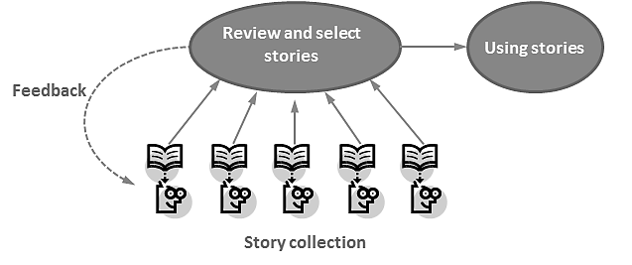
The bare bones of MSC
Collection of stories – in response to a particular question which includes a WHAT? and a WHY?
Selection of stories – review and filter
Feedback- discuss & communicate the process and results of story selection
Analysis & Use
Notes:
Feedback – like any good M&E – it needs to be feedback for proper use and learning

Slide 9
The MSC question
  MSC story collection begins by searching for the answer to a simple question, such as:
  “Looking back over the last year, what do you think was the most significant change as a result of your involvement in the ‘xx ‘ project?”
  And then asks “Why was this significant to you?”

Slide 10
In MSC, stories provide:
Information about instances of project impact
Information about how people value these impacts
Dialogue about
what is
important
Notes:
Story + Significance + DISCUSSION regarding what is most important

Slide 11
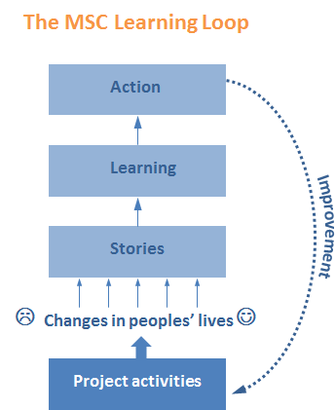

Slide 12
MSC: A “quick and dirty” comparison with other approaches
MSC | Traditional monitoring/evaluation approaches
1.Inductive 2. Diversity of views (beneficiaries and field staff) 3. Open questioning 4. Participatory analysis of data 5. Contextual “thick description” 6. About learning and improving 7. Outer edges of experience | Deductive Indicators often determined by senior staff Closed or specific questions Analysis by management Based on numbers, no context About ‘proving’ Central tendencies
Notes:
Those on left could probably be said of most qualitative approaches

Slide 13
When MSC works best
MSC works best in programs that:
have diverse & emergent outcomes
operate in contexts of high complexity
are focused on social change
are participatory in ethos
are struggling with conventional monitoring systems
if the organisation/project/program is ready for it!
Notes:
MSC is better suited to some program contexts than others. In a simple program with easily defined outcomes (such as vaccination, perhaps), quantitative monitoring maybe sufficient and would certainly consume less time than MSC. In other program contexts, however, conventional monitoring and evaluation tools may not provide sufficient data to make sense of program impacts and foster learning.

Slide 14
Organisational enablers for MSC
an organisational culture that encourages learning
champions (i.e. people who can promote the use of MSC) with good facilitation skills
a willingness to try something different
time to run several cycles of the approach
infrastructure to enable regular feedback of the results to stakeholders
commitment by senior managers.
Notes:
After this then have a discussion re some other examples where it has been used.

Slide 15
When MSC may not be the best fit
If you mainly want to:
develop good news stories for public relations (PR)
understand the ‘average’ experience of participants
produce an evaluation report for accountability purposes
Notes:
There are also some instances where MSC costs may not justify the benefits. While MSC can be used to address the following, there may be other less time-consuming ways to achieve the same objectives:

Slide 16
A CASE STUDY:
OSI TANATA

Slide 17
Osi Tanata: An MSC case study
Background:
NGO in Bougainville, PNG
Formerly Oxfam NZ Program
Approximately 8 staff (all local)
Community development & training project
Main aims - reconciliation and reconstruction

Slide 18
“Looking back over the last few months, in your opinion, what do you think was the most significant change that took place as a result of the support / training you received from Osi Tanata?”
  Stories were collected:
  by Osi Tanata staff (some also collected by an external evaluator)
  from project beneficiaries
  How:
  during an interview – usually informal i.e. under a tree
  Using a story collection guide

Slide 19
Exercise Osi Tanata: instructions
  Imagine you are members of the board of Osi Tanata.
  Select the story you consider to be most significant by reaching group consensus
  Hint: don’t set the criteria in advance – use your gut instinct. Try to reach consensus!

Slide 20
Exercise Osi Tanata: instructions
One person to read story 1 aloud
After listening to the story, together discuss what are the key points and main outcomes in the story. SUSPEND JUDGEMENT! Write outcomes on note papers. Repeat for stories 2 & 3
After you have heard all three stories individually think about which story you consider the most significant and why.
Share your choice and reasons with your group
Discuss and try to reach a consensus in your group on one story. Be prepared to feedback your selection and reasons to us all.

Slide 21
Notes:
Use more than one word to describe the OUTCOME

Slide 22
Reflections on case study
Notes:
What did you think?
Selection? – easy to compare? Why/why not? What did you discuss?
Quality of stories? Were they as easy as each other to ascertain what the change was and why it was significant?
Pull out lessons from this – hard to decide,

Slide 23
Present back- Osi Tanata selected stories
Tell us what story your group selected and offer some reflection on the process involved in selecting that story – what did you consider/how did you reach consensus?
How did you describe why you chose that story as the most significant?

Slide 24
The MSC Process
Purpose
Define the purpose of using MSC in your program
Core MSC Processes
Collect stories
Select stories
Additional analysis and use of stories
Incorporate MSC into reporting and communication
Feedback
Adapt your program
Managing stories
Additional analysis

Slide 25
The MSC Process
1.DEFINING THE PURPOSE

Slide 26
MSC for monitoring or evaluation?
How you choose to use MSC within the program cycle depends on:
Your primary purpose
The frequency with which you will/are able to implement the process
Whichever approach you opt for it is important to understand that MSC is not a stand alone technique, but an important addition to an monitoring and/or evaluation. It should fill the gaps and complement your other methods.

Slide 27
MSC within the program cycle
Monitoring tends to be:
      Primarily for project management- an internal process
      In MSC this is on-going cycles of collection, selection and reflection
      Evaluation tends to be:
      MSC can be used as one line of data – in a one-off manner
      Done less frequently than monitoring
      More analytical – involves judgements of merit or worth
Notes:
MSC was originally developed for monitoring purposes but was radically different as had no indicators – called “Impact Monitoring”

Slide 28
Benefits of a MSC as a monitoring tool
  provides more immediate information about impact
  encourages more regular reflection
  it has greater potential to build capacity of staff and foster ownership of M&E by staff
  However, the resources and time required to implement MSC on such a regular basis mean that it may not be practical to maintain short cycles!
Notes:
Short loop!

Slide 29
“Longer loop” learning:
MSC for evaluation
MSC has also been successfully adapted for evaluation.
MSC is used as part of a suite of data collection methods.- as one line of evidence!
A ‘significant change’ story may be captured as part of a more extensive semi-structured interview.

Slide 30
Other possible purposes for using MSC
To understand complex changes that cannot easily be enumerated
To capture the voice of those the initiative is targeting (i.e. ‘beneficiaries’ or ‘participants’)
To identify unexpected changes
To fill a gap in existing M&E data
To encourage reflective practice
Notes:
Other purposes too…

Slide 31
Logan Together (LT) example:
Outcomes harvesting + MSC
Step 1:
Design outcomes harvest
Step 2 & 3: Develop and refine outcome descriptions
Step 4: Substantiate and verify
Descriptions + contribution + significance + verification
Consider LT collective and backbone respectively
Preliminary data analysis by
Clear Horizon
Collect data: Document scan, scoping, interviews, MSC, quantitative data collection & analysis
Step 5:
Measure & analyse progress
Case studies & MSC stories
Independent review of findings by Clear Horizon
Agreed progress markers
Frame, scope, KEQs
Develop tools for data collection & verification
Co-analysis & interpretation with LT stakeholders
‘Evidence’ artefacts for reflection workshop
Raw data for identifying outcomes, from key informants
Snowball sampling & additional MSC stories for verification
Set of MSC stories

Slide 32
If you chose to use MSC in your context what purpose(s) would you have?

Slide 33
Let’s take a break!

Slide 34
The MSC Process
Purpose
Define the purpose of using MSC in your program
Core MSC Processes
Collect stories
Select stories
Additional analysis and use of stories
Incorporate MSC into reporting and communication
Feedback
Adapt your program
Managing stories
Additional analysis

Slide 35
The Core MSC Processes
1. STORY COLLECTION

Slide 36
The MSC question
  MSC story collection begins by searching for the answer to a simple question, such as:
  “Looking back over the last year, what do you think was the most significant change as a result of your involvement in the ‘xx ‘ project?”

Slide 37
Components of the question
  ‘Looking back over the last year…’ –refers to a specific time period- adjustable!
  ‘…what do you think was...’ –asks respondents to exercise their own judgment.
  ‘…the most significant…’ – asks respondents to be selective, not to try to comment on everything, but to focus in and report on one thing.
  ‘…change…’ – asks respondents to be more selective, to report a change rather than static aspects of the situation or something that was present previously.
  ‘…your involvement with xx project?’ – like the first part of the sentence, this establishes some boundaries & can also be adjusted.

Slide 38
“Capturing” the story
The initial MSC question forms the basis of the information we are seeking.
In reality a number of additional probing questions are usually needed in order to ‘capture’ the full story and enable a good understanding of context and significance!
Notes:
May be an interview – but may be other ways to capture

Slide 39
Probing without leading
What?
When?
Where?
Why?
Who?
Can you explain/describe?
  that
How did you feel?
Can you explain how things are different now?
  What it was like before/after?
Why is that important to you?
Notes:
These are important BOTH to ensure enough context is ascertained AND also to build rapport

Slide 40
How to collect stories?
There are several ways in which stories can be identified, then documented:
Individual Interview and note taking
During group discussion
Story writers write directly
Staff write stories they have heard
or know about
The choice of method depends on how actively you want to search for new SC stories, and how much time and resources are available.

Slide 41
Who to collect stories from?
This is highly dependent on your particular work/project and what you want to understand more about!
Stories are often collected from:
“Beneficiaries”/Program participants/Clients
Project staff
Project partners or other key stakeholders

Slide 42
Documenting the story
The “captured” story is documented into a form that can be reviewed by a number of people and can be circulated among different groups of stakeholders.
The documented story then acts as the basis for discussion about what is important- this is during the selection process.
Notes:
Thus v impt to get story in best possible shape

Slide 43
What is a story?
A beginning
A middle
An ending
Why is this significant?
Captures the perspective and values of the storyteller
What was the situation before the change happened?
Background or context
What happened?
The nature of the change the project provided
What was the situation after the change?
The difference the change made to the life of the storyteller
Notes:
Think re Osi Tanata – weren’t always quite that well written. Not enough context and/or identification of significance. MAY not always be this linear but important to get these chunks!
In good MSC stories – all of this MUST be documented!! (Plus some of the details about the interview itself/date etc)

Slide 44
Key information to be documented
Information about who collected the story, who told the story and when
Description of the story itself – what happened
Significance (to the storyteller) of the events described in the story
Often the most important bit!

Slide 45
Ethics of story collection
Attention must be paid to the ethics of collecting stories from individuals.
We suggest that you develop processes to track consent right from start.
Three key ethical considerations are:
Voluntary participation
Informed consent
Privacy and storing information

Slide 46
Practical ethics for MSC
The person collecting the story needs to explain how the story is to be used and to check that the storyteller is happy for their story to be used in that way (informed consent)
The storyteller should also be asked whether they wish their name to accompany the story.
Ask the storyteller to consult with others mentioned in a story to check whether they are happy for their name to be mentioned or not.
The storyteller should have the option to review their story, particularly if it is edited in any way.

Slide 47
Editing considerations
We want the story in a reasonable narrative form! Since MSC is about hearing the ‘voice’ of your participants, you need to treat editing sensitively.
  Chopping?
  Changing order?
  Editing words?
Yes to:
  Punctuation changes/ typos
  Deleting rambles
  Substituting names
Notes:
Make sure story has ID or name !!
Don’t include all the questions – but make sure to address the key ones!

Slide 48
Verification
It is important to verify some stories – to check that the story of what happened is factually correct
This may be particularly important where you find data inconsistencies
  i.e. MSC tells you one thing but other data tells you something different
Not always a critical component of MSC but can add strength to the process
Notes:
ALSO…NOT just verifying the facts of the story BUT it can lead to digging deeper into aspects from a story or stories that you want more evidence of – so will survey etc

Slide 49
Exercise
In work groups:
Who do you think it would be important to collect MSC stories from?
How would you collect them?
Are there any particular ethics, issues or factors to consider when collecting stories from these groups?

Slide 50
The MSC process
Purpose
Define the purpose of using MSC in your program
Core MSC Processes
Collect stories
Select stories
Additional analysis and use of stories
Incorporate MSC into reporting and communication
Feedback
Adapt your program
Managing stories
Additional analysis

Slide 51
The Core MSC Processes
2. STORY SELECTION

Slide 52
Selection is a key tool of MSC
People don’t like it necessarily
It can put people out of their comfort zone
It ensures people really read the stories
It’s a technique to get people to enter into deeper level of dialogue
But it’s not about the choice – it’s about the dialogue and about surfacing values!
The final reasons for selecting a particular story should be documented and attached to that story .
Notes:
Central to MSC is the review and selection of stories. This is where most learning occurs as the process encourages an in-depth conversation about the initiative in question. During selection, stories are analysed for meaning and outcomes. The selection process is therefore a form of reflective practice, something which is often lacking in project management.
The reasons for selecting an SC story as the most significant should be documented and attached to the story. Because documenting the reasons for selection is usually the last task in a selection meeting, there is a risk that this will be done too hastily and that what is written will not do justice to the depth of discussion or the quality of the judgments made. Explanations should be more than a few key words, such as ‘more sustainable’ or ‘gender equity’. Full sentences should be used to express what was seen as significant in the selected SC story. If multiple criteria were used to justify the selection of a story, these should be listed along with an explanation of their relative importance.

Slide 53
Some common selection processes
There are as many possible ways of selecting stories as there are programs, but broadly speaking there two main approaches :
Flat (for smaller volumes of stories)
Hierarchical (generally for large volumes of stories)
Notes:
There are different approaches to organising a selection process and the structure depends on the particular programmatic or organisational context. Selection structures normally reflect the organisational structure whether that be hierarchical or flat.

Slide 54
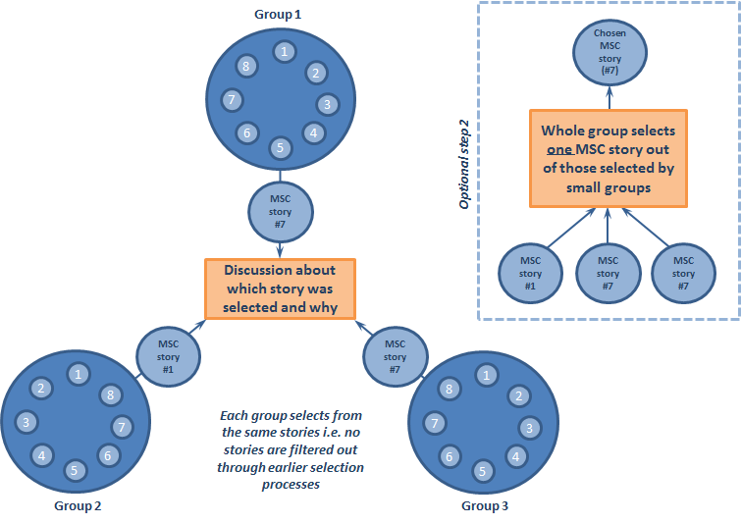
Notes:
This is like what we did with the Osi Tanata stories. In a flat structure, different groups can select from the same stories and then share which story they selected and why. You can either leave the selection process here, and end up with multiple stories of significant change and the reasons for their selection or take the process one step further.
These types of selection processes are best used when you have a small volume of stories – it would be impractical to ask each small group to read fifty stories and choose the most significant.

Slide 55
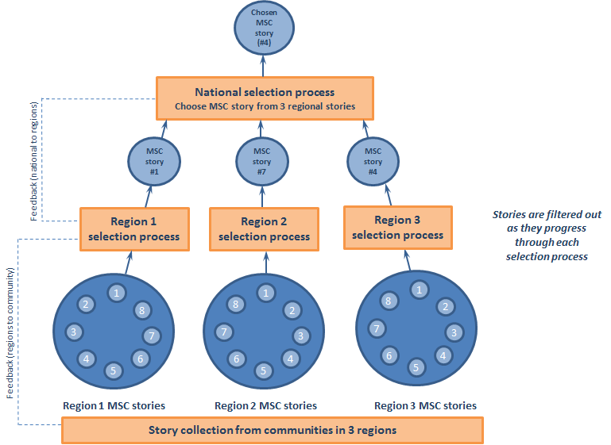
National Level
Notes:
Hierarchical – selection moves from one level to the next with progressively smaller no of stories. The diagram above illustrates this process. In this example, the selection process at the national level involves three stories (selected by each of the three regions), rather than the full 24 stories collected (eight stories from each of the three regions). This type of selection process can be useful if you are planning to collect a large volume of stories.

Slide 56
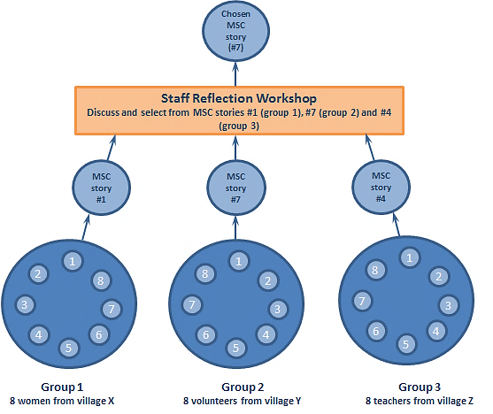
Notes:
A hierarchical selection process can also incorporate the views of project beneficiaries, if this is an important consideration for your organisation. In the diagram below, MSC stories were collected from a group of women, a group of volunteers and a group of teachers. Each of these stakeholder groups were asked to choose the most significant change for their group. These chosen stories were then used in a staff reflection workshop. At the workshop, staff chose the most significant story from their perspective.

Slide 57
Helpful selection options
Negotiation: look at all the choices; through discussion try and come to a decision about one story
Facilitated discussion/ iterative votes
Secret ballot: number the stories, then individually write on a piece of paper the number of the story, fold up.
Scoring/Ranking: stories are given a score or rating. These are then added up and the story with the highest rating overall is selected
Notes:
Facilitated versus non-facilitated
Negotiation: This method is similar to iterative voting but tends not to be facilitated. Each person states which story they wish to select and why. This is followed by a discussion of the merits of each story and reason for selection until a consensus or agreement is reached. As with the previous method if consensus is not possible the views of those who do not agree are recorded. This process requires staff to be able to argue their case and can be a good way to foster this skill. There is the danger however that those who dominate the discussion or are more skilled at negotiation may end up determining which story is selected.
Secret Ballot: This process can be surprisingly useful, especially if there are power inequalities in the group, or if people are initially reluctant to cast their votes publicly. It is important to remember that in MSC, transparency is an important way of making subjectivity accountable. Therefore, it is very important to add the second step of capturing and discussing the reasons for choice.
Ranking: . It is also a method that can be used remotely, as well as in face-to-face meetings. The downside is the limited opportunity for dialogue, although explanations for ratings can be given at the same time as the ratings. Explanations are especially important when a participant rates an SC story much higher or lower than other participants

Slide 58
Domains and selection
Domains are broad categories of changes
Their purpose is to:
  Help with story selection
  Enable different types of stories to be considered together in same round
  Help track changes against objectives
Domains are usually only necessary when you have a lot of stories or if there are some clear groups of stories
They can be decided after you have collected the stories
Notes:
Tracking against objectives: looking at how often stories from each domain are selected (or described) compared to others…can assist in thinking re what project is achieving

Slide 59
Examples of domains
Types of change
  Changes in the quality of people’s lives
  Changes in the nature of people’s participation
  Lessons learnt
Sector or area
  Environmental
  Health
  Youth justice
  Education
Types of stakeholders
  Executives or management
  Community members/project participants
  Project team
Notes:
Talk about LESSONS learnt- as a place to put the negative stories
WE WON’T use Domains in our selection process.

Slide 60
The MSC process
Purpose
Define the purpose of using MSC in your program
Core MSC Processes
Collect stories
Select stories
Additional analysis and use of stories
Incorporate MSC into reporting and communication
Feedback
Adapt your program
Managing stories
Additional analysis

Slide 61
The Core MSC Processes
3. FEEDBACK
Notes:
A little more theory before looking again at our own stories

Slide 62
Feedback
It is important to ensure information from an MSC process is shared within an organisation and to those from whom stories are gathered from, as it:
  facilitates learning
  is an important aspect of work/program improvement
What to feedback?
  Results of selection with reasons
  Comments on stories
  Recommendations for action
How?
  Use what works already – or get creative – visual, verbal, written?

Slide 63
The MSC process
Purpose
Define the purpose of using MSC in your program
Core MSC Process
Collect stories
Select stories
Additional analysis and use of stories
Incorporate MSC into reporting and communication
Feedback
Adapt your program
Managing stories
Additional analysis

Slide 64
Additional analysis & use of stories
Notes:
NOW stepping into the analysis and use of stories

Slide 65
Managing your stories
When you are collecting stories, it is important to keep a track of where they have come from.
You might track:
  Who collected the story
  Region/ location collected from
  Characteristics about the storyteller (e.g. age, gender)
  Relationship to the program (e.g. field staff, beneficiary)
  Whether story was selected or not
  Whether any recommendations need to be made and/or acted upon as a result of the story
Notes:
Practical tips! Partic impt if using repeatedly in monitoring. Records some of the demographic stuff BUT also things about learning/actions

Slide 66
Meta-analysis
If you have a record of information about your stories, you can conduct ‘meta-monitoring’
Meta-monitoring looks for patterns across the stories that are collected or selected.
For example:
  Are more stories collected from particular stakeholder groups or locations?
  Are particular types of stories being selected?
  Are there gaps in stories collected?
Notes:
Best done when used over time . Are certain groups left out or stories you expected not being told etc

Slide 67
Secondary analysis
The core MSC process involves collecting stories, selecting stories and providing feedback.
But you can go further! Your MSC stories are a rich source of data.
Secondary analysis refers to the process used to delve into stories more deeply, and can involve a variety of methods.
Core MSC Process
  Collect stories
  Select stories
  Feedback

Slide 68
Examples of secondary analysis
To identity types of MSCs
To identify differences and similarities between different stakeholders in terms of their views of what are MSCs
To analyse the consequences and/or causes of the MSCs
Notes:
The sky is the limit – analysis depends on what you need to know! SECONDARY ANALYSIS IS ABOUT ASKING “WHAT IS THIS TELLING US?”
One form of secondary analysis in MSC is to quantify the emergence of a particular theme across a random sample of the population -

Slide 69
Secondary analysis; thematic.
Let’s look at all of our story outcomes and ask…
How could we group these?
What do we see?
Do they confirm anything?
Are they telling us anything new?
Is anything not being said?
What further questions do they provoke?
Do they connect with the overall program aims?

Slide 70
Reporting and communication
Stories provide useful information about what is happening on the ground
  can be useful learning for others involved in similar initiatives
  can be a good way of promoting the voice of community members.
Reporting MSC stories:
  MSC stories can be incorporated into an outcome/impact evaluation or annual report.
  Sometimes they are used as a standalone booklet.

Slide 72
Tips for training others
Notes:
NOW stepping into the analysis and use of stories

Slide 73
Teaching MSC to others
Best learning comes from having a go
Utilise the available resources for training –
free online content & take homes from today
Contextualise or adapt to suit use
Help work out logistics
eg. Recording and documenting
Have consistent ethical protocols
Buddy up, at least for first one or two
Tools/framework for cross story analysis

Slide 74
Where to from now for you?
What are the strengths you see of using MSC?
What are the challenges or weaknesses?
What are the first steps for you to take to begin using MSC well?
What barriers might there be?
How would you address those to ensure success?
What is YOUR role to support the use of MSC?
Any other questions/considerations?
Notes:
Can you see a place for it in your context? How can you see it being rolled out? Where would you start? Who needs to do what to get this going?

Slide 75
Additional resources
MSC user guide
Workbook
Training Notes
MSC user group
Notes:
Email out with these links and with Notes and Workbook

Slide 76
Thanks!

